Slide 1

CONTENT MANAGEMENT SYSTEM
Submitted by:-
Sambit Kumar Pradhan(UBs16CSC201)
AKASh kumar behera(Ubs16csc216)
Guided by:-
Mr. Samit kumar pradhan

Slide 2
CONTENT
Introduction
Scope
Users
System Features
Use Case Diagram
High Level Design
Data Flow Diagram
Sequence Diagram
ER Diagram
Implementation
Screenshots
Testing
Demo
Conclusion

Slide 3
INTRODUCTION

Slide 4
SCOPE
Education institution

Slide 5
USER
Student
TEACHER

Slide 6
System Features
Categorization of standard
Add Contenten
Access Content
Faculty Details
Update Slider

Slide 7
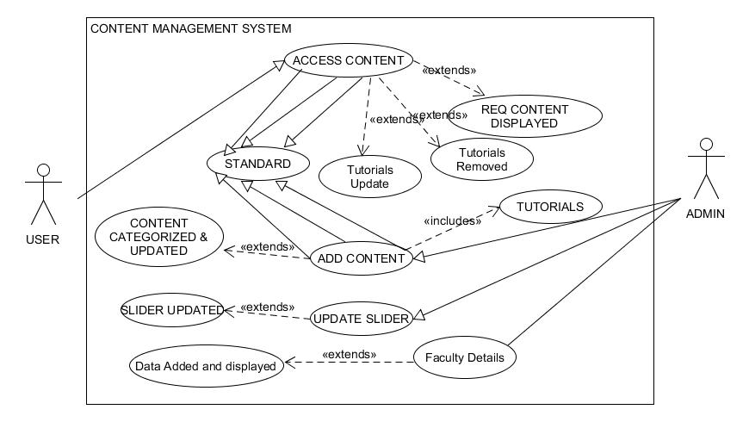
Use Case Diagram

Slide 8
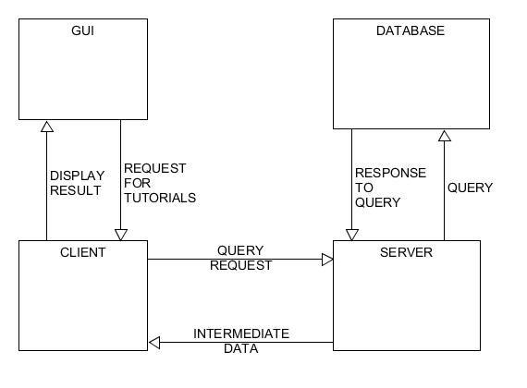
High Level Design

Slide 9
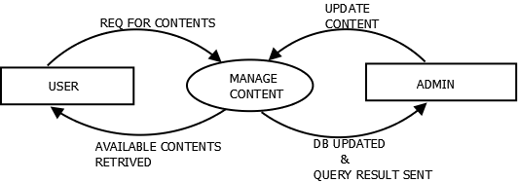
Data Flow design level 0

Slide 10
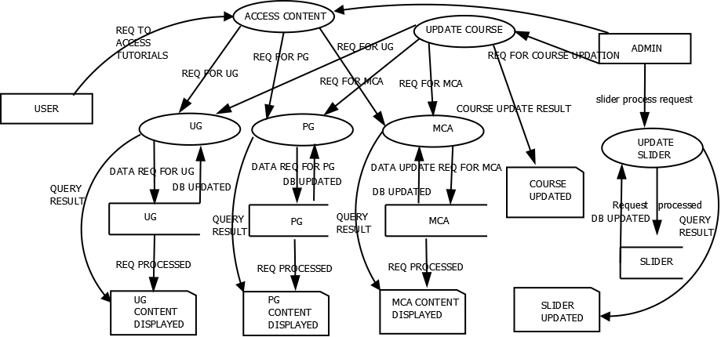
Data Flow design level 1

Slide 11
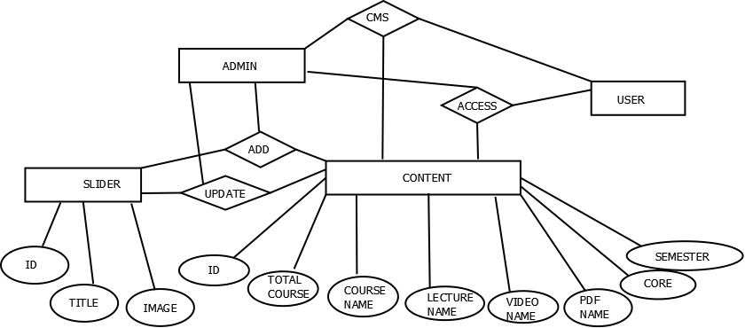
Database Design

Slide 12
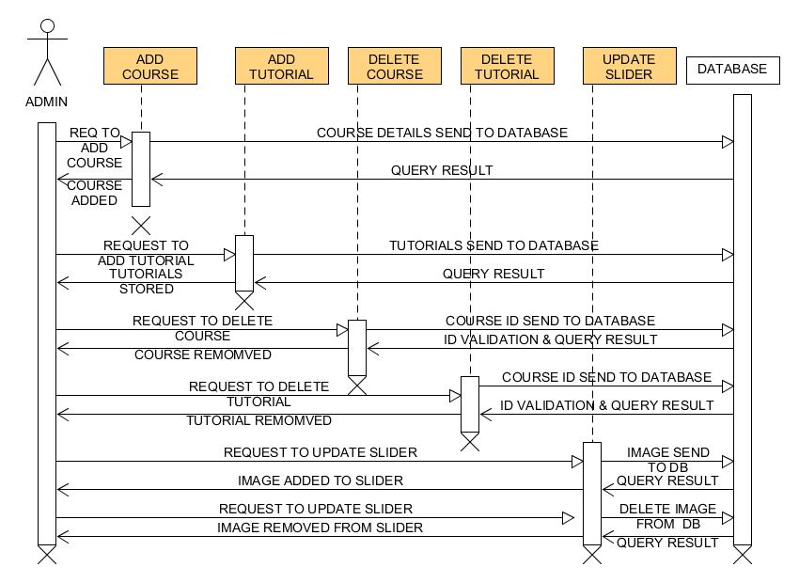
Sequence Diagram of Admin

Slide 13
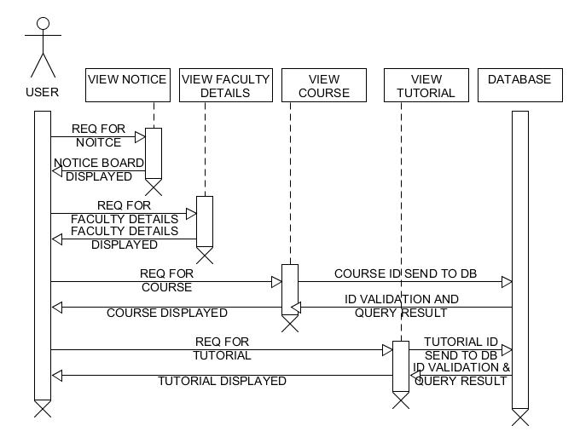
Sequence Diagram of User

Slide 14
Implementation
Tools Used:
Front End: HTML,CSS, Bootstrap , JavaScript
Server Scripting: PHP
Database: MySQL
Server: Apache

Slide 15
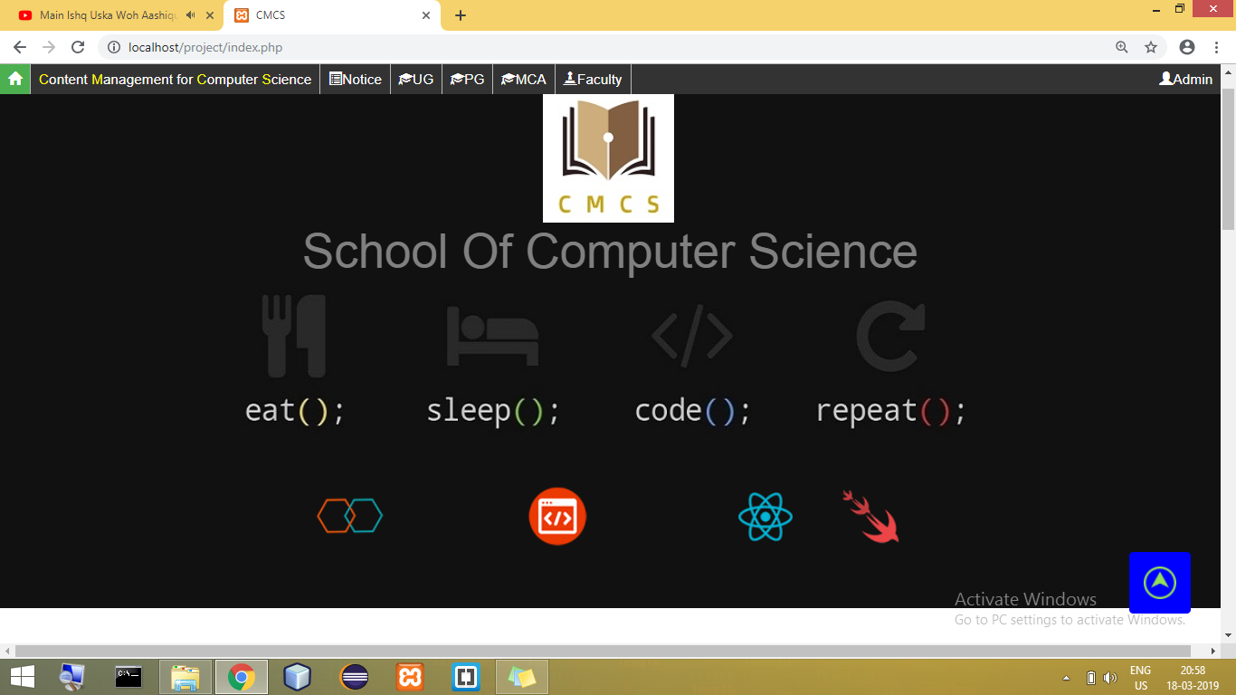
Screenshots of Home Page

Slide 16
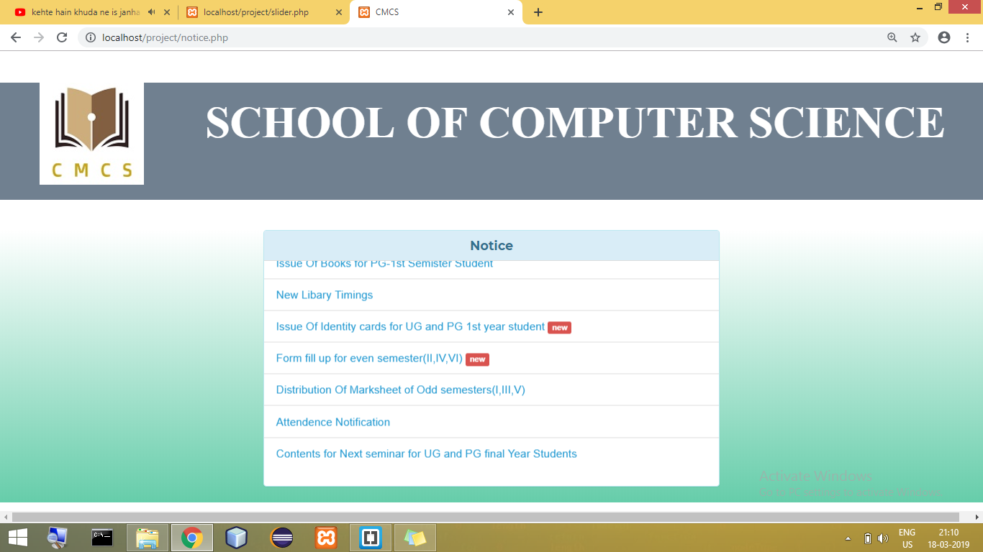
Screenshots of Notice Page

Slide 17
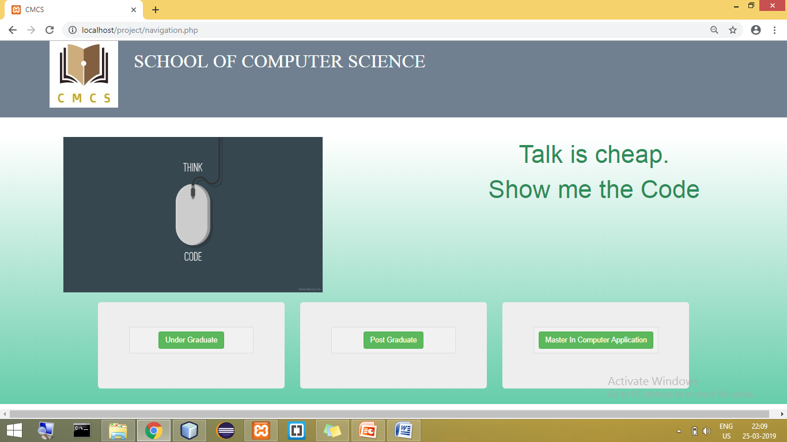
Screenshots of Course Page

Slide 18
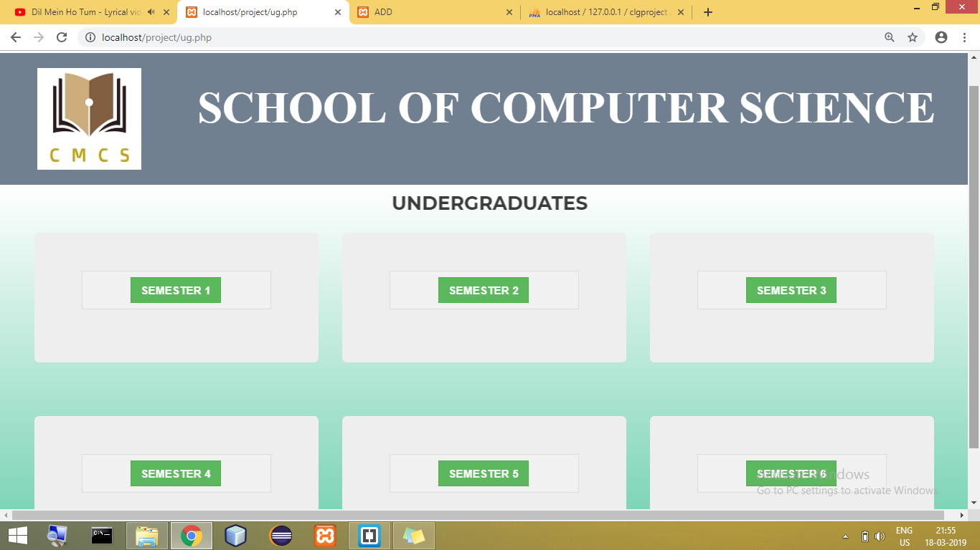
Screenshots of Semester Page

Slide 19
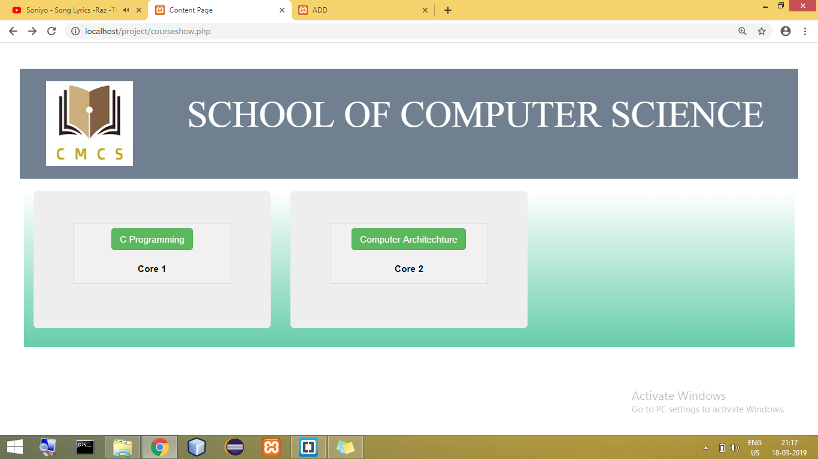
Screenshots of Core Page

Slide 20
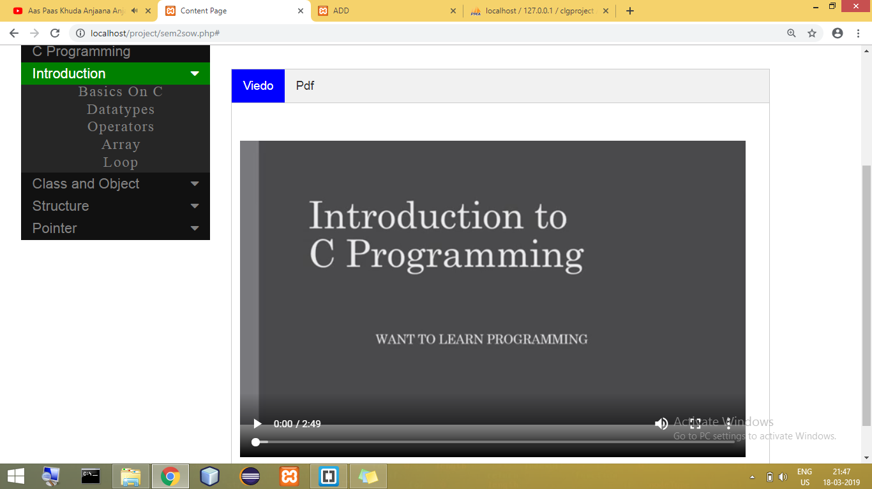
Screenshots of Tutorial Page

Slide 21
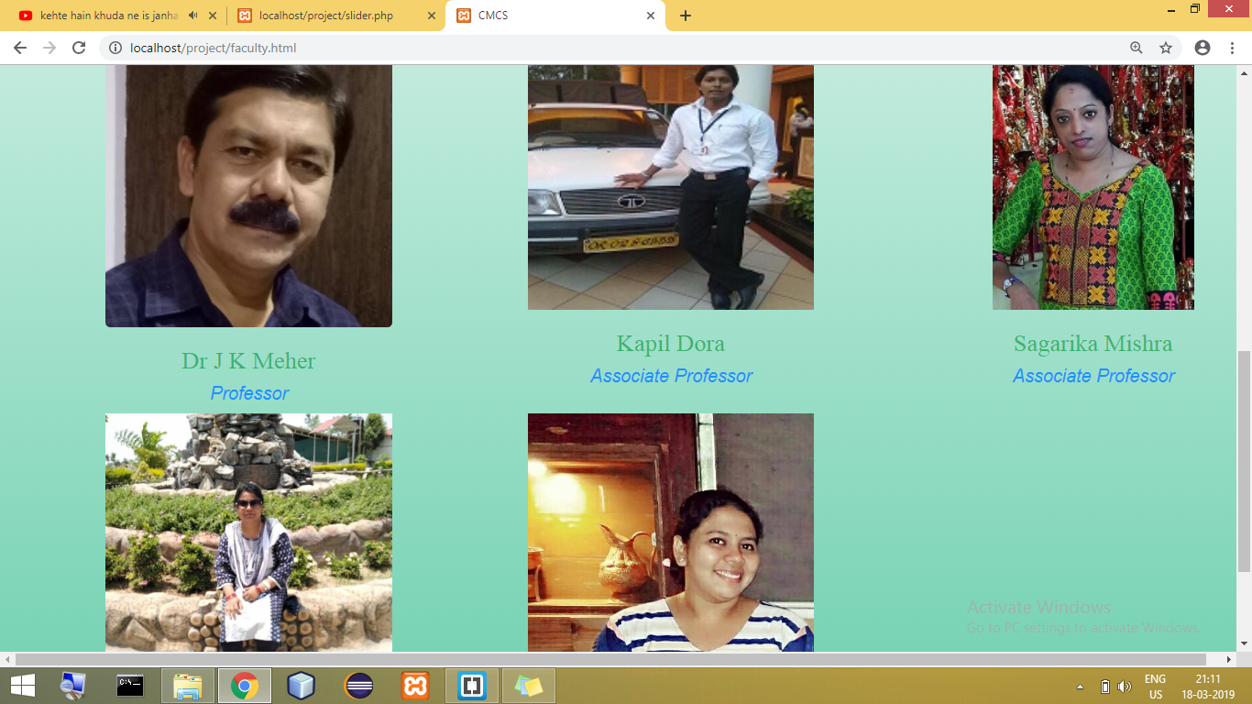
Screenshots of Faculty Page

Slide 22
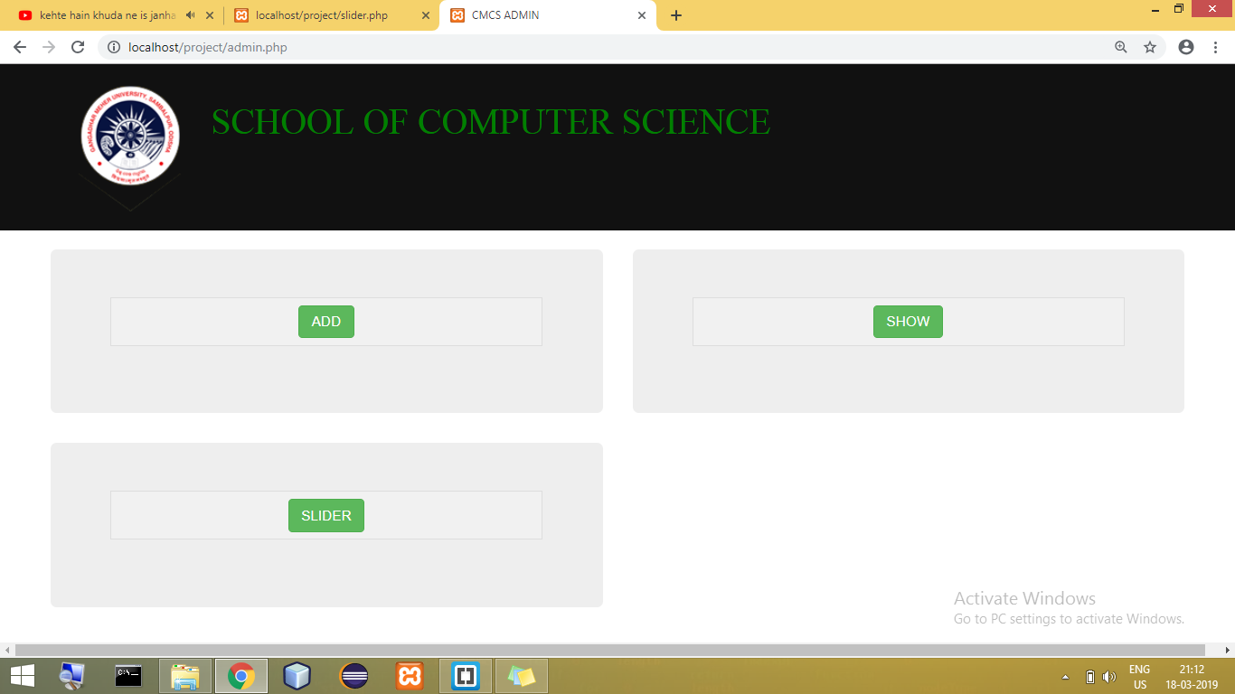
Screenshots of Admin Page

Slide 23
Testing
Test Case Id: CMS01
Test Case: To check the adding of course to db by not selecting standard(UG/PG/MCA).
Purpose: To check whether the course is added to db or not.
Input Data Requirements: Standard,Coursename,Semester,Core Number.
Expected Output: Course not to be stored in database.
Pass/Fail: Pass
Let's See

Slide 24
Testing
Test Case Id: CMS18
Test Case: To check whether the tutorial is retrived from db when all required data are selected .
Purpose: To check whether the tutorial is retrieved from db or not.
Input Data Requirements: Standard,Semester,Core.
Expected Output: Tutorial has retrived database.
Pass/Fail: Pass
Let's Test

Slide 25
DEMO
Content Management system

Slide 26
Conclusion
The website content management system is an automaton system for any educational institute or any organization. Here through this website a student or any learner can access video lectures and pdf of any topic or subject their institution is offering. After this they can download the study materials, syllabus, question papers. The administrator of our website can have the access to all the tutorials, faculty details, course and many other things and can update the same. The admin can delete the old tutorials and add new one.This web application can be used at any educational institute and can be used for a better service.

Slide 27
THANK YOU

